Slide 1
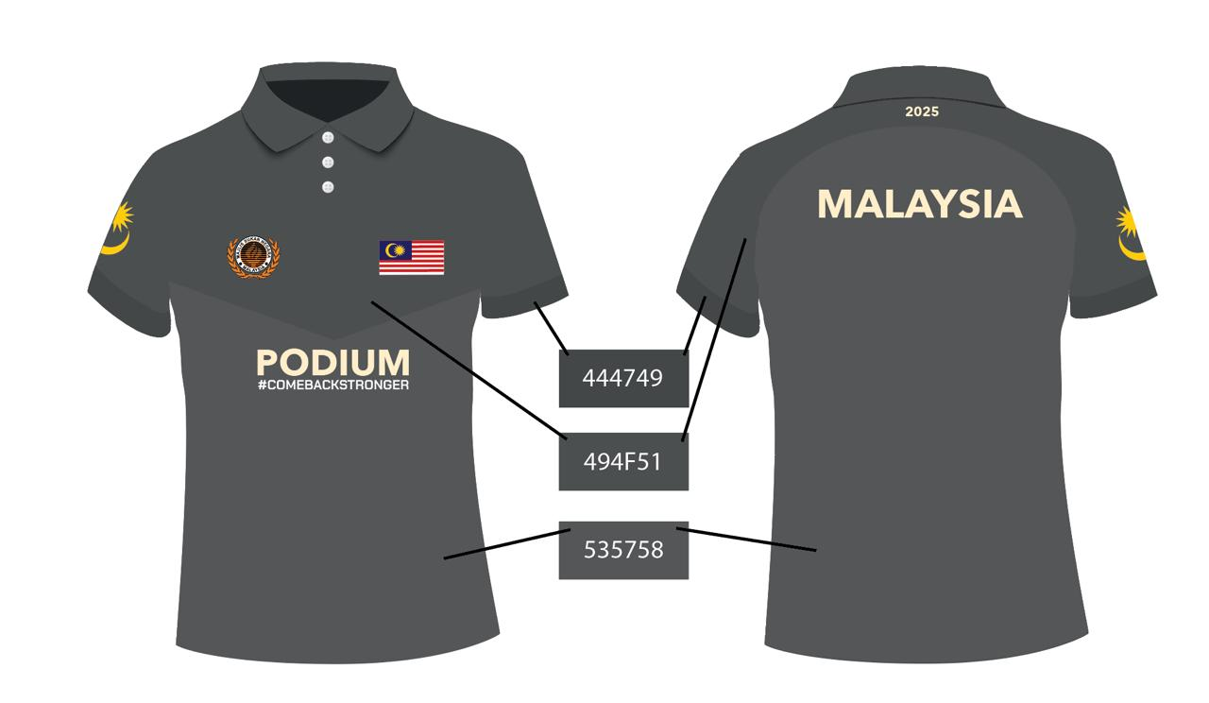
LOGO TEAM MSN

Slide 2
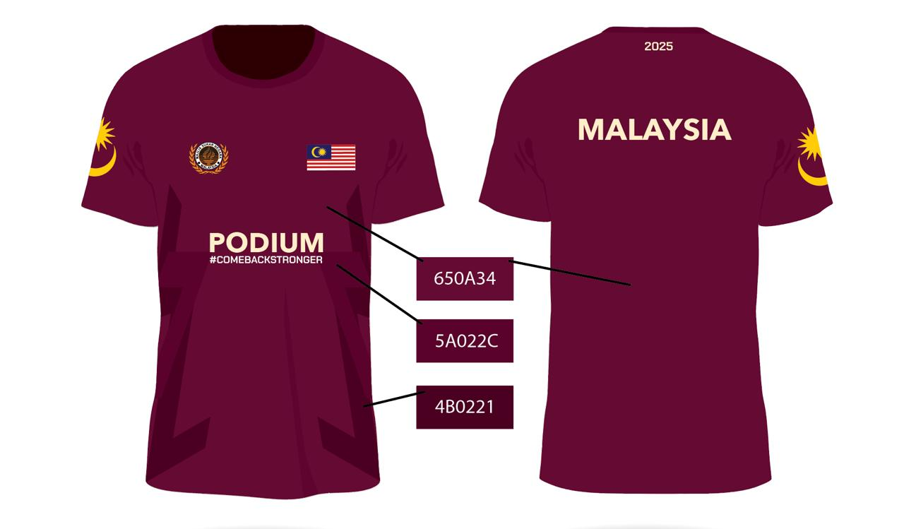
LOGO TEAM MSN

Slide 3
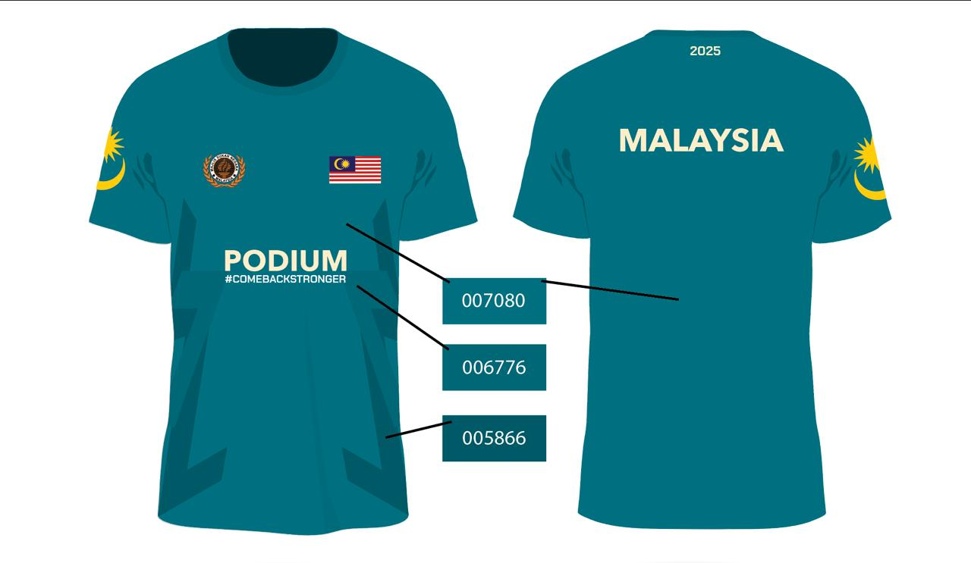
LOGO TEAM MSN

Slide 4
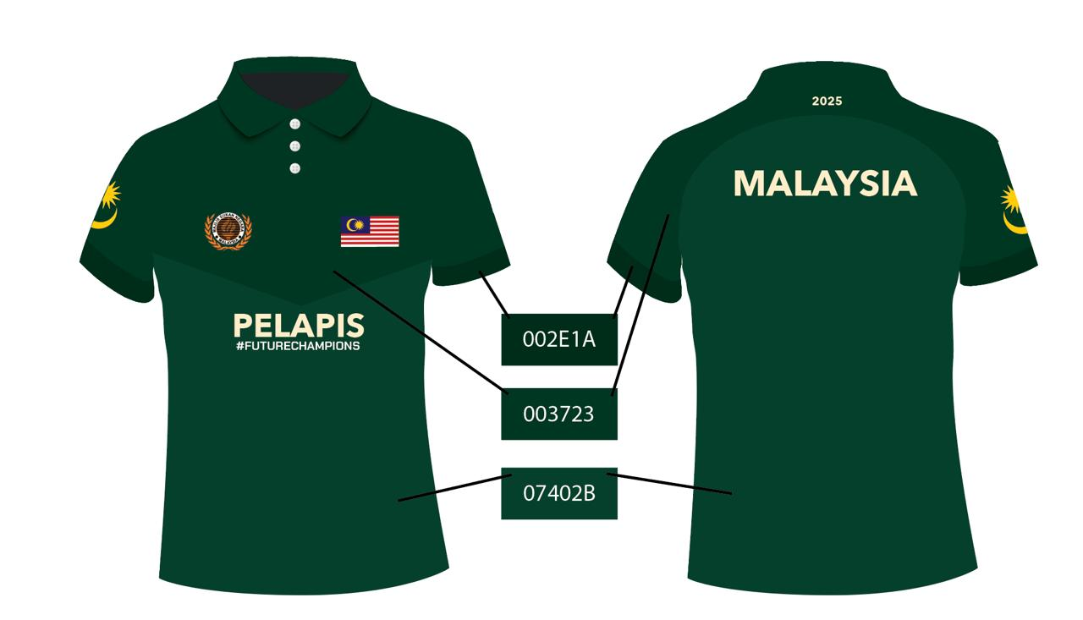
LOGO TEAM MSN

Slide 5
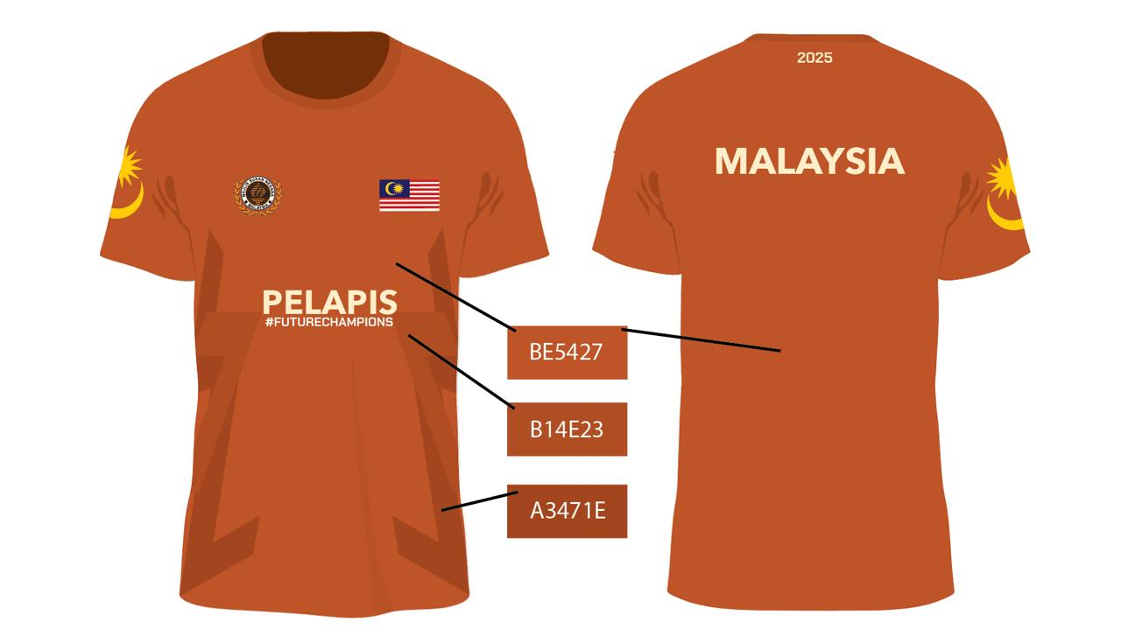
LOGO TEAM MSN

Slide 6
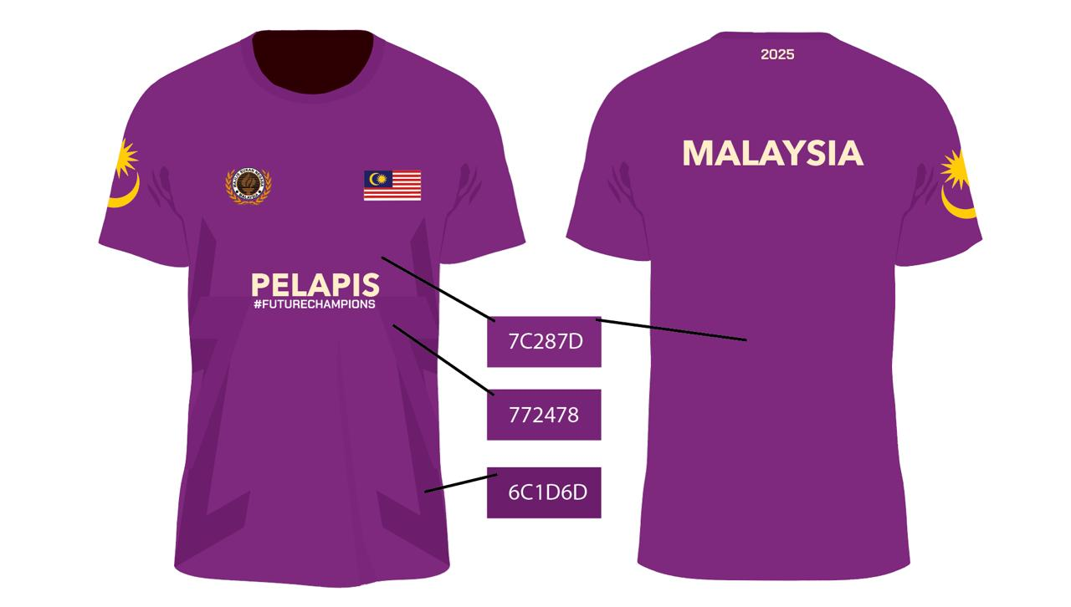
LOGO TEAM MSN

